Slide 1
Algorithm Efficiency
There are often many approaches (algorithms) to solve a problem.
  How do we choose between them?
At the heart of computer program design are two (sometimes conflicting) goals
  To design an algorithm that
    is easy to understand, code, debug.
    makes efficient use of the resources.

Slide 2
Estimation Example
How many library bookcases does it take to store books totaling one million pages?
Estimate:
  Pages/inch
  Feet/shelf
  Shelves/bookcase
Notes:
Pages/inch: Guess 500
Feet/shelf: Guess 4, actually 3
Shelves/bookcase: Guess 5, actually 7
Units check: pages/in x ft/shelf x shelf/bookcase ⇒ pages/bookcase

Slide 3
Analysis of Algorithms
An algorithm is a finite set of precise instructions for performing a computation or for solving a problem.
What is the goal of analysis of algorithms?
  To compare algorithms mainly in terms of running time but also in terms of other factors (e.g., memory requirements, programmer's effort etc.)
What do we mean by running time analysis?
  Determine how running time increases as the size of the problem increases.
Notes:
Pages/inch: Guess 500
Feet/shelf: Guess 4, actually 3
Shelves/bookcase: Guess 5, actually 7
Units check: pages/in x ft/shelf x shelf/bookcase ⇒ pages/bookcase

Slide 4
Input Size
Input size (number of elements in the input)
  size of an array
  polynomial degree
  # of elements in a matrix
  # of bits in the binary representation of the input
  vertices and edges in a graph
Notes:
Pages/inch: Guess 500
Feet/shelf: Guess 4, actually 3
Shelves/bookcase: Guess 5, actually 7
Units check: pages/in x ft/shelf x shelf/bookcase ⇒ pages/bookcase

Slide 5
Best, Worst, Average Cases
Not all inputs of a given size take the same time to run.
Sequential search for K in an array of n integers:
  Begin at first element in array and look at each element in turn until K is found
Notes:
Best: Find at first position. Cost is 1 compare.
Worst: Find at last position. Cost is n compares.
Average: (n+1)/2 compares IF we assume the element with value K is equally likely to be in any position in the array.

Slide 6
Worst Case
Provides an upper bound on running time.
An absolute guarantee that the algorithm would not run longer, no matter what the inputs are.

Slide 7
Best Case
Provides a lower bound on running time.
Input is the one for which the algorithm runs the fastest.

Slide 8
Average Case
Provides an estimate of “average” running time.
Assumes that the input is random.
Useful when best/worst cases do not happen very often
  i.e., few input cases lead to best/worst cases.

Slide 9
Which Analysis to Use?
While average time appears to be the fairest measure,
  it may be difficult to determine.
When is the worst case time important?
Notes:
Average time analysis requires knowledge of distributions. For example, the assumption of distribution used for average case in the last example.
Worst-case time is important for real-time algorithms.

Slide 10
How to Measure Efficiency?
Critical resources:
  Time, memory, programmer effort, user effort
Factors affecting running time:
  For most algorithms, running time depends on “size” of the input.
  Running time is expressed as T(n) for some function T on input size n.
Notes:
Empirical comparison is difficult to do “fairly” and is time consuming.
Critical resources: Time. Space (disk, RAM). Programmers effort. Ease of use (user’s effort).
Factors affecting running time: Machine load. OS. Compiler. Problem size. Specific input values for given problem size.

Slide 11
How do we analyze an algorithm?
Need to define objective measures.
(1) Compare execution times?
Empirical comparison (run programs)
Not good: times are specific to a particular machine.
(2) Count the number of statements?
Not good: number of statements varies with programming language and programming style.

Slide 12
Understanding Rate of Growth (cont’d)
The low order terms of a function are relatively insignificant for large n
n⁴ + 100n² + 10n + 50
Approximation:
n⁴
Highest order term determines rate of growth!

Slide 13

Rate of Growth ≡ Asymptotic Analysis
Using rate of growth as a measure to compare different functions implies comparing them asymptotically
  i.e., as n →
If f(x) is faster growing than g(x), then f(x) always eventually becomes larger than g(x) in the limit
  i.e., for large enough values of x

Slide 14
The Growth of Functions
A problem that can be solved with polynomial worst-case complexity is called tractable
Problems of higher complexity are called intractable
Problems that no algorithm can solve are called unsolvable

Slide 15
Visualizing Orders of Growth
On a graph, as
you go to the
right, a faster
growing
function
eventually
becomes
larger...
f_{A}(n)=30n+8
Value of function →
f_{B}(n)=n²+1
Increasing n →

Slide 16
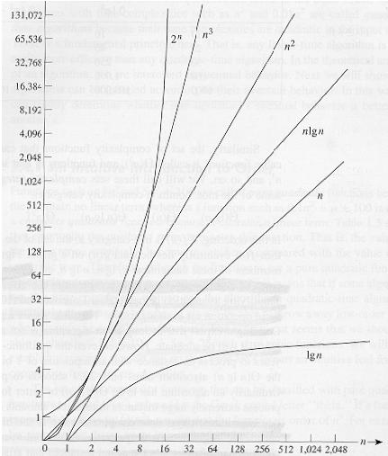
Common orders of magnitude

Slide 17
Complexity
Let us assume two algorithms A and B that solve the same class of problems.
The time complexity of A is 5,000n, the one for B is ⎡1.1^{n}⎤ for an input with n elements
For n = 10,
  A requires 50,000 steps,
  but B only 3,
  so B seems to be superior to A.
For n = 1000, A requires 5⋅10⁶ steps,
  while B requires 2.5⋅10⁴¹ steps.

Slide 18
N log₂N N*log₂N N² 2^{N}
1 0 0 1 2
2 1 2 4 4
4 2 8 16 16
8 3 24 64 256
16 4 64 256 65,536
32 5 160 1024 4.29*10⁹
64 6 384 4096 1.84*10¹⁹
128 7 896 16,384 3.40*10³⁸

Slide 19
Algorithm speed vs function growth
An O(n²) algorithm will be slower than an O(n) algorithm (for large n).
But an O(n²) function will grow faster than an O(n) function.
f_{A}(n)=30n+8
Value of function →
f_{B}(n)=n²+1
Increasing n →

Slide 20
Running Time Examples
Algorithm 1 Cost
arr[0] = 0; c₁
arr[1] = 0; c₁
arr[2] = 0; c₁
...
arr[N-1] = 0; c₁
-----------
c₁+c₁+...+c₁ = c₁ x N
Algorithm 2 Cost
for(i=0; i<N; i++) c₂
arr[i] = 0; c₁
-----------
(N+1) x c₂ + N x c₁ = (c₂ + c₁) x N + c₂

Slide 21
Running Time Examples (cont.’d)
Cost
sum = 0; c₁
for(i=0; i<N; i++) c₂
for(j=0; j<N; j++) c₂
sum += arr[i][j]; c₃
------------
c₁ + c₂ x (N+1) + c₂ x N x (N+1) + c₃ x N x N

Slide 22
How do we find f(n)?
Associate a "cost" with each statement
(2) Find total number of times each statement is executed
(3) Add up the costs

Slide 23
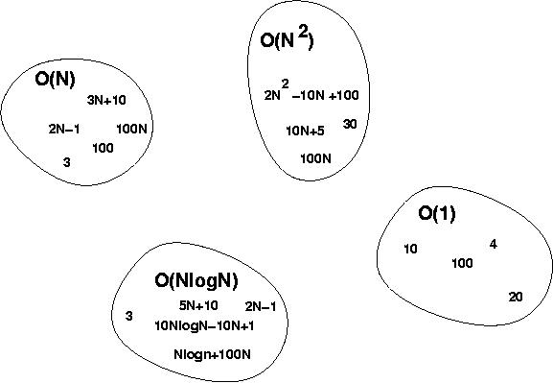
Big-O Visualization
O(g(n)) is the set of functions with smaller or same order of growth as g(n)

Slide 24
More Running Time Examples
i = 0;
while (i<N) {
X=X+Y; // O(1)
result = mystery(X); // O(N)
i++; // O(1)
}
The body of the while loop: O(N)
Loop is executed: N times
N x O(N) = O(N²)

Slide 25
More Running Time Examples (cont.’d)
if (i<j)
for ( i=0; i<N; i++ )
X = X+i;
else
X=0;
Max ( O(N), O(1) ) = O (N)
O(N)
O(1)

Slide 26
Complexity Examples
What does the following algorithm compute?
int who_knows(int a[], int n) {
int m = 0;
for (int i = 0; i<n; i++)
for (int j = i+1; j<n; j++)
if ( abs(a[i] – a[j]) > m )
m = abs(a[i] – a[j]);
return m;
}
returns the maximum difference between any two numbers in the input array
Comparisons: n-1 + n-2 + n-3 + … + 1 = (n-1)n/2 = 0.5n² - 0.5n
Time complexity is O(n²)

Slide 27
Complexity Examples
Another algorithm solving the same problem:
int max_diff(int a[n]) {
int min = a[0];
int max = a[0];
for (int i = 1; i<n; i++)
if ( a[i] < min )
min = a[i];
else if ( a[i] > max )
max = a[i];
return max-min;
}
Comparisons: 2n - 2
Time complexity is O(n).

Slide 28
Names of Orders of Magnitude
“Popular” functions g(n) are n log n, log n, 1, 2^{n}, n², n!, n, n³
Listed from slowest to fastest growth:
O(1) bounded (by a constant) time
O(log₂N) logarithmic time
O(N) linear time
O(N*log₂N) N*log₂N time
O(N²) quadratic time
O(N³) cubic time
O(2^{N} ) exponential time

Slide 29
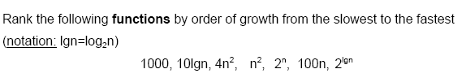

Examples (cont.’d)

Slide 30
Examples of Growth Rate
/* @return Position of largest value in "A“ */
static int largest(int[] A) {
int currlarge = 0; // Position of largest
for (int i=1; i<A.length; i++)
if (A[currlarge] < A[i])
currlarge = i; // Remember position
return currlarge; // Return largest position
}
Notes:
As n grows, how does T(n) grow?
Cost: T(n) = c₁n + c₂ steps

Slide 31
Examples (cont)
sum = 0;
for (i=1; i<=n; i++)
for (j=1; j<=n; j++)
sum++;
Notes:
Example 3: Cost: T(n) = c₁n² + c². Roughly n² steps, with sum being n² at the end. Ignore various overhead such as loop counter increments.

Slide 32
Time Complexity Examples (1)
a = b;
This assignment takes constant time, so it is O(1).
sum = 0;
for (i=1; i<=n; i++)
sum += n;
Notes:
Asymptotic analysis is defined for equations. We need to convert programs to equations to analyze them.
The traditional notation is Θ(1), not Θ(c).
Θ(n) even though the value of sum is n².

Slide 33
Time Complexity Examples (2)
sum = 0;
for (j=1; j<=n; j++)
for (i=1; i<=j; i++)
sum++;
for (k=0; k<n; k++)
A[k] = k;
Notes:
First statement is Θ(1). Double for loop is Σi = Θ(n²). Final for loop is Θ(n). Result: Θ(n²).

Slide 34
Time Complexity Examples (3)
sum1 = 0;
for (i=1; i<=n; i++)
for (j=1; j<=n; j++)
sum1++;
sum2 = 0;
for (i=1; i<=n; i++)
for (j=1; j<=i; j++)
sum2++;
Notes:
The only difference is j<=n vs. j<= i. First loop, sum is n². Second loop, sum is (n+1)(n)/2. Both are Θ(n²).

Slide 35

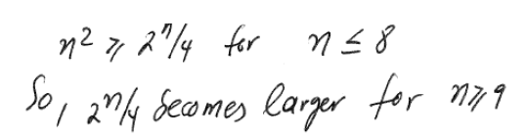
Examples (cont.’d)

Slide 36
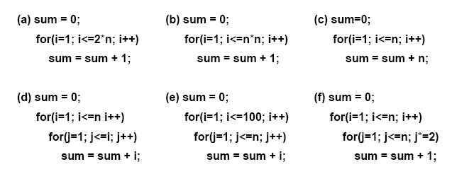
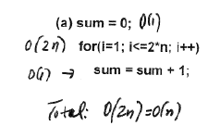
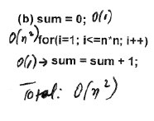
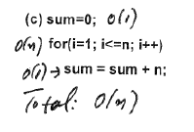
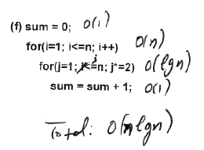
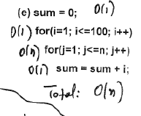
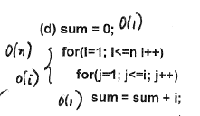
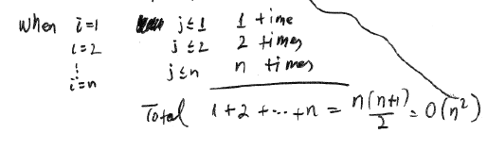
Analyze the complexity of the following code segments

